Slide 1


MACHINE LEARNING USING PYTHON
DONE BY :
1.PARTHA PRATIM MAZUMDER
2.NAVIN SHARMA
3.PRAVESH KUMAR

Slide 2

TOPIC NO.4 : WINE QUALITY TESTING
NIELIT - HARIDWAR
DOMAIN : MACHINE LEARNING USING PYTHON
AUGUST BATCH

Slide 3

OVERVIEW
Basics understanding of Wine.
Objective
Data description
Importing modules
Study dataset
Visualization
Normalization
Applying model

Slide 4
WHAT WE HAVE USED IN THIS PROJECT!
PROGRAMMING LANGUAGE USED : PYTHON
DATASET : WWW.KAGGLE.COM
IDE : JUPYTER NOTEBOOK
LIBRARIES USED :
NUMPY
PANDAS
MATPLOTLIB
SEABORN
AND VARIOUS MACHINE LEARNING ALGORITHMS

Slide 5
INTRODUCTION
“Wine is the most healthful and most hygienic of beverages” – Louis Pasteur
we are discussing wine, above quote seems to be right because all over the world wine was so popular among people, and 5% of the population doesn’t know what is wine? sounds good. We definitely came across the fruit graphs, which is so sweet on the test but graphs are not just to eat, they are used to make different types of things. Wine is one of them Wine is an alcoholic drink that is made up of fermented grapes.

Slide 6
OBJECTIVES
Our main objective is to predict the wine quality using machine learning through Python programming language.
A large dataset is considered and wine quality is modelled to analyse the quality of wine through different parameters like fixed acidity, volatile acidity etc.
All these parameters will be analysed through Machine Learning algorithms like random forest classifier algorithm which will helps to rate the wine on scale 1 - 10 are bad - good.
Output obtained would further be checked for correctness and model will be optimized accordingly.
It can support the wine expert evaluations and ultimately improve the production.

Slide 7
DESCRIPTION OF DATASETS
We will be used to classify the quality of wine, many of them are chemical, so we need to have a basic understanding of such chemicals.
volatile acidity : Volatile acidity is the gaseous acids present in wine.
fixed acidity : Primary fixed acids found in wine are tartaric, succinic , citric, and malic
residual sugar : Amount of sugar left after fermentation.
citric acid : It is weak organic acid, found in citrus fruits naturally.
chlorides : Amount of salt present in wine.
free sulfur dioxide : So2 is used for prevention of wine by oxidation and microbial spoilage.
total sulfur dioxide pH : In wine pH is used for checking acidity
density
sulphates : Added sulfites preserve freshness and protect wine from oxidation, and bacteria.
alcohol : Percent of alcohol present in wine.

Slide 8
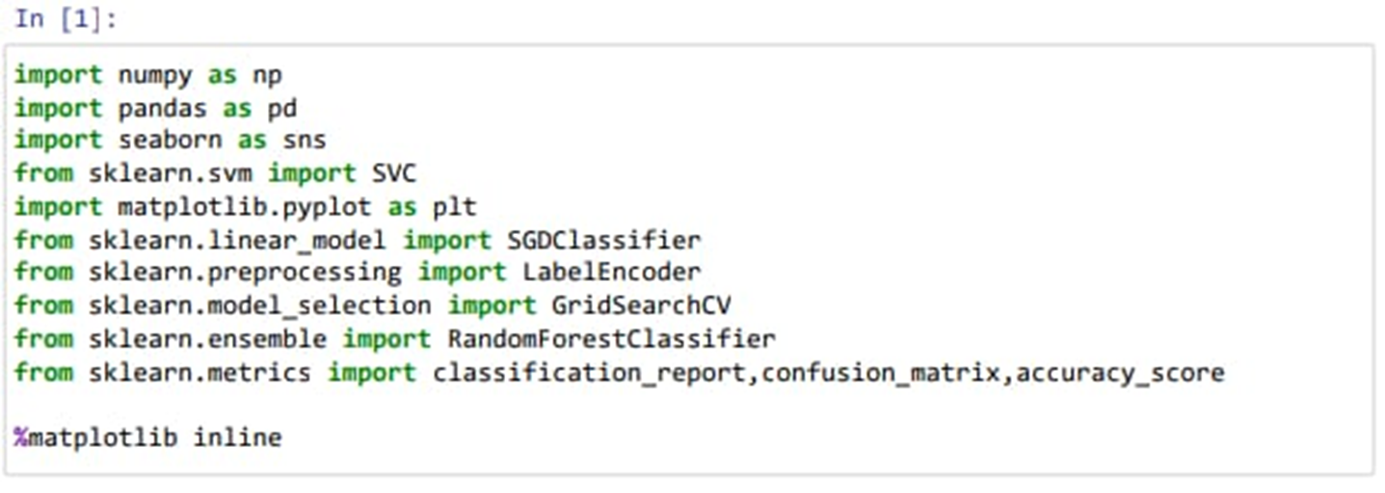
FEW GLIMPSES OF OUR CODING

Slide 9
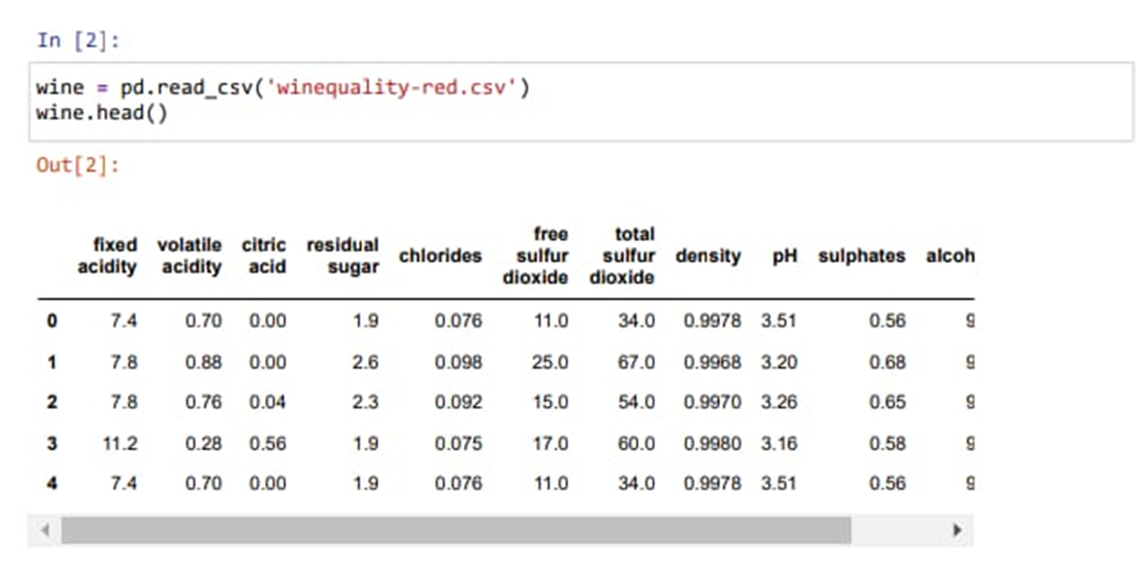

Slide 10
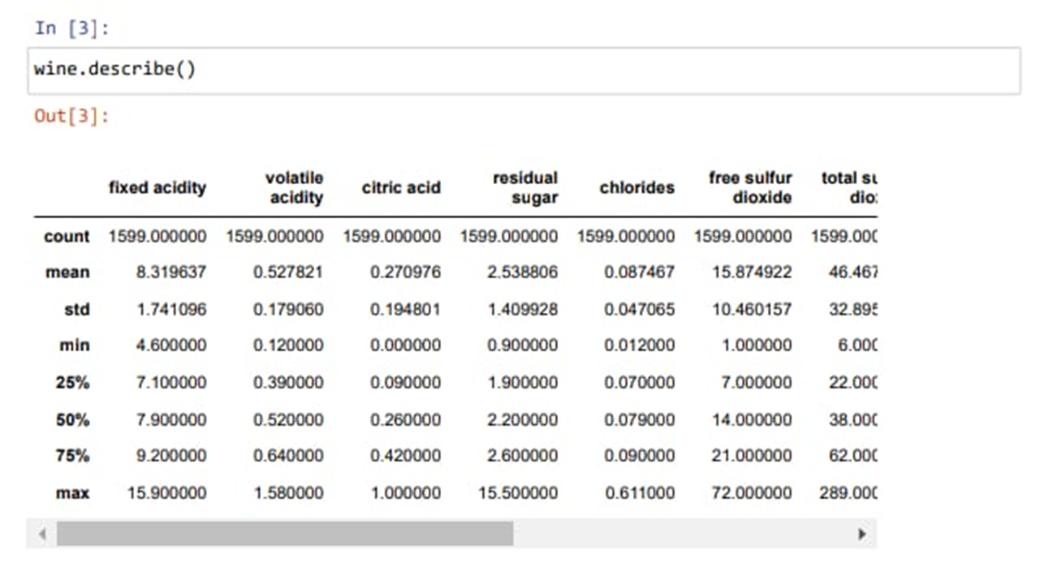

Slide 11
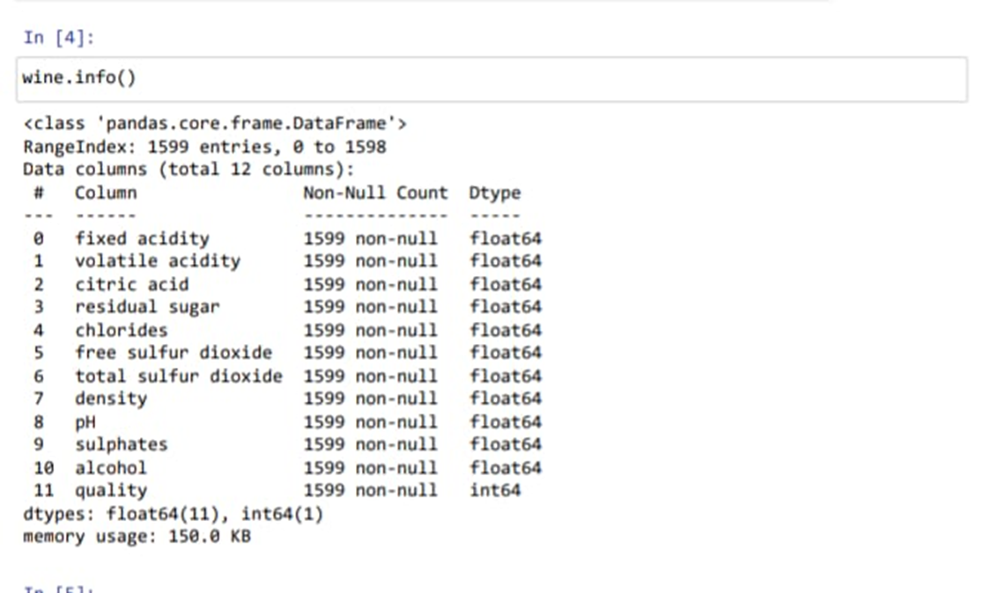

Slide 12
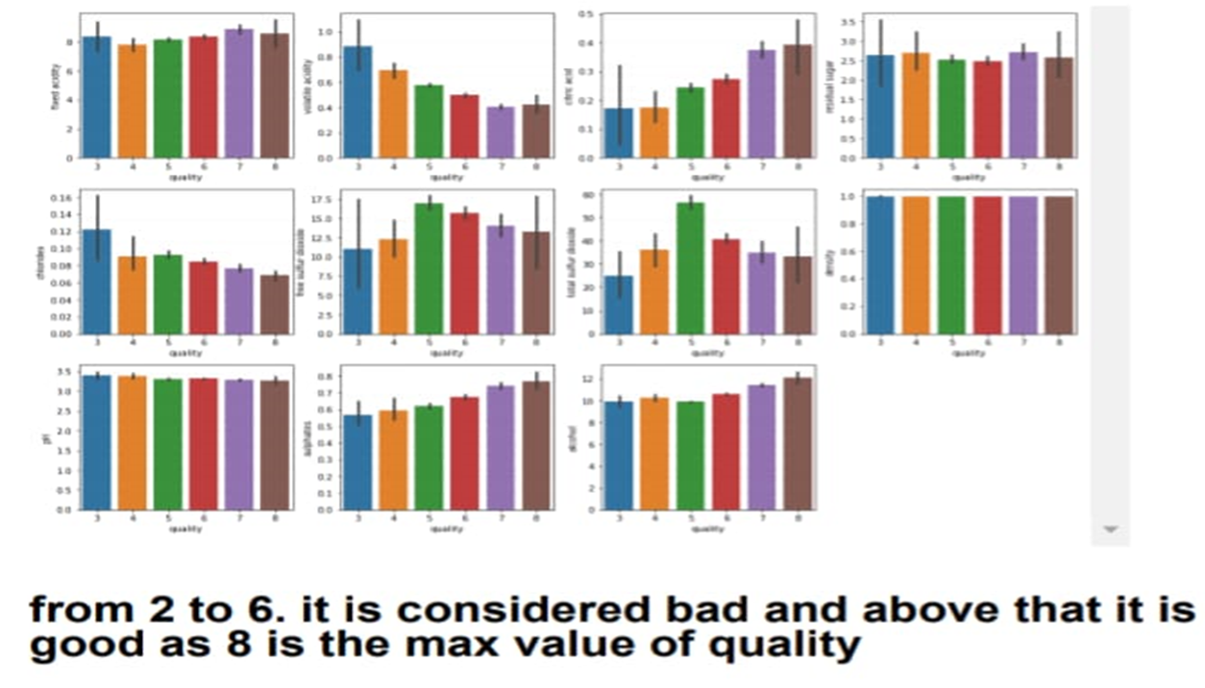

Slide 13
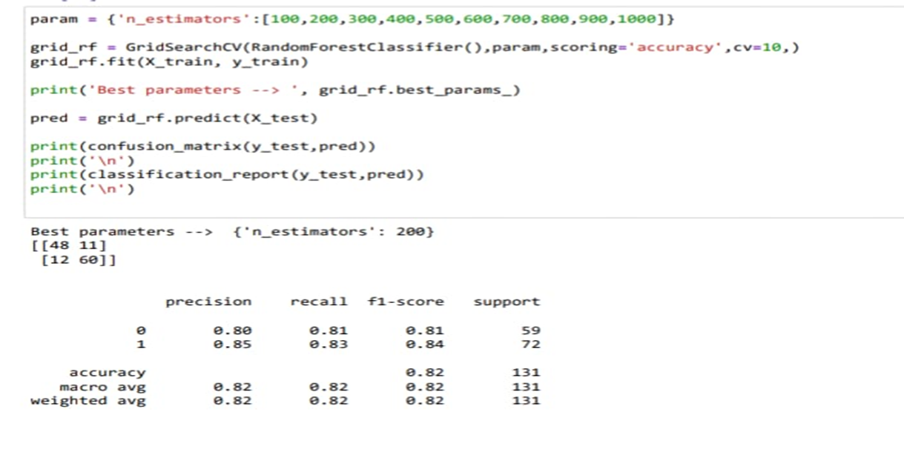

Slide 14
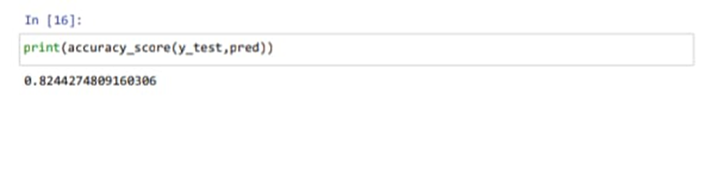
Conclusion:-

Slide 15
THANKYOU FOR WATCHING

